Slide 1
10th Rochdale Beavers Quiz
True or False

Slide 2
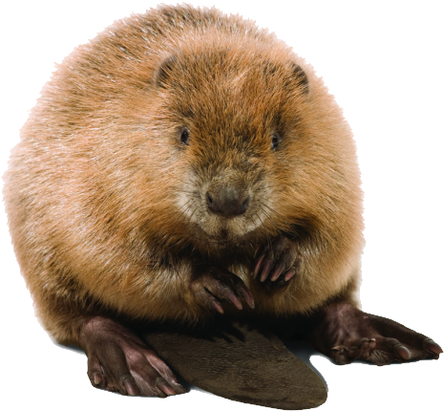
Question 1
A Beaver Lives in a lodge
Answer – True.

Slide 3
Question 2
During the Stone Age, most people lived in nice big houses
Answer: False

Slide 4
Question 3
If you are thirsty, drinking water is good for you
Answer: True

Slide 5
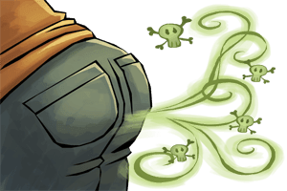
Question 4
Adults fart on average 14 times per day
Answer: True

Slide 6
Question 5
Omelettes are made from eggs and orange juice to make them look yellow
Answer: False

Slide 7
Question 6
The Scout world membership Badge has a Granny knot on it?
Answer: False (Reef)

Slide 8
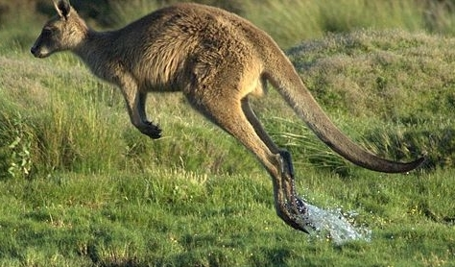
Question 7
A Kangaroo can walk backwards
Answer - False

Slide 9
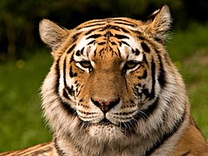
Question 8
Tigers have striped skin, not just striped fur
Answer: True

Slide 10
Question 9
Beavers have Orange teeth
Answer: True

Slide 11
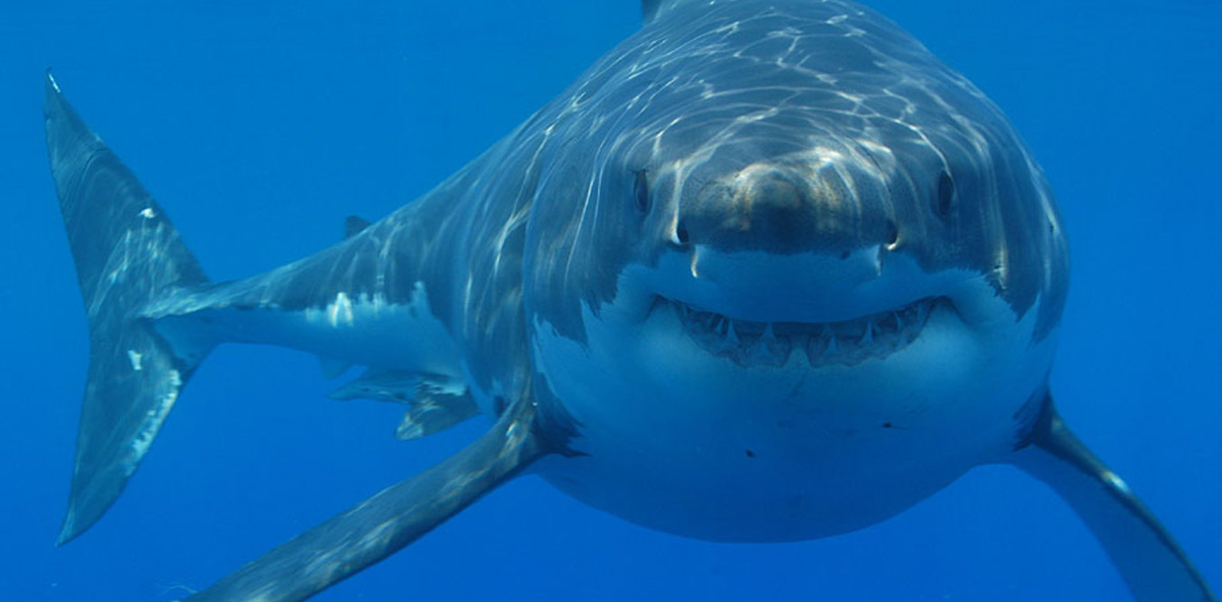
Question 10
A shark can blink it’s eyes
Answer: True

